Slide 1

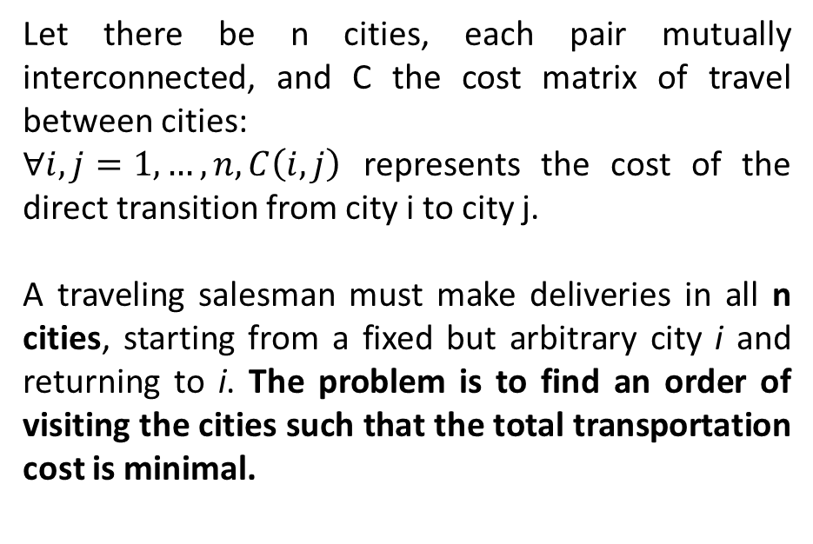
The Traveling Salesman Problem
Let there be n cities, each pair mutually interconnected, and C the cost matrix of travel between cities:
$∀i,j=1,…,n, C\left(i,j\right)$ represents the cost of the direct transition from city i to city j.
A traveling salesman must make deliveries in all n cities, starting from a fixed but arbitrary city i and returning to i. The problem is to find an order of visiting the cities such that the total transportation cost is minimal.

Slide 2
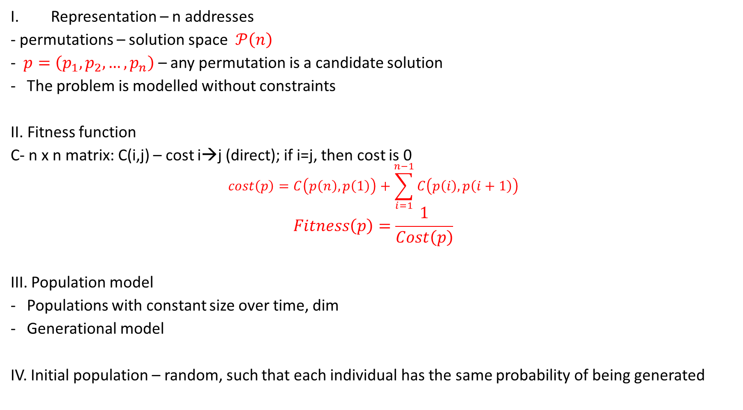
The Traveling Salesman Problem
Representation – n addresses
- permutations – solution space $𝒫\left(n\right)$
- $p=\left(p_{1},p_{2},…,p_{n}\right)$ – any permutation is a candidate solution
The problem is modelled without constraints
II. Fitness function
C- n x n matrix: C(i,j) – cost i→j (direct); if i=j, then cost is 0
$$cost\left(p\right)=C\left(p\left(n\right),p\left(1\right)\right)+\sum_{i=1}^{n−1}{C\left(p\left(i\right),p\left(i+1\right)\right)}$$
$$Fitness\left(p\right)=\frac{1}{Cost\left(p\right)}$$
III. Population model
Populations with constant size over time, dim
Generational model
IV. Initial population – random, such that each individual has the same probability of being generated
Looking to minimize this function (cost minimization)
Fitness function (looking to maximize)

Slide 3
The Traveling Salesman Problem
V. Mutation
Mutation takes place with a small probabilty; pm = mutation probability
The problem is modelled with individuals represented through permutations → mutation takes place at individual level
Pm = k/Dim → on average, the number of individuals for which mutation takes place is k
At population level – the general schema for mutation for problems modelled without constraints, using representations through permutations
At individual level
The problem involves adjacency dependence – mutation by inversion

Slide 4
The Traveling Salesman Problem
VI. Crossover
With high probability; pc = probability of crossover ( 0.6,0.7…)
Generational model → the generation of dim descendants must be ensured
dim parents → dim descendants : with probability pc the resulting (new descendants) individuals are new, and the rest come from the parents through asexual crossover
At population level – general crossover scheme for problems without constraints
The particular operator/method for crossover is chosen specifically for problems with adjacency dependency– PMX (Partially Mapped Crossover)

Slide 5
The Traveling Salesman Problem
VII. Selection of parents
Number of parents – based on the used model (dim)
Fitness score is positive → any probability of selection can be used (FPS or rank) simulated with the SUS mechanism (recommended) or roulette
Possible choices – FPS with sigma scaling and SUS/roulette;
VIII. Replacement of the current population (Selection of Next Generation)
Replacement mechanism – based on the used model (generational)
All offspring (descendants) are propagated, except when the best ”old” individual (from the current generation) is better than all new individuals → elitism

Slide 6
The Traveling Salesman Problem
IX. Conditions for continuing the search for best solution
The number NMAX evolutive cycles (generations) has not yet been exceeded.
There are at least 2 individuals in the population that have different fitness score (otherwise the genetic variability is null)
During the last K evolutive cycles the best quality score has changed at least once, where K=NMAX/3

Slide 7
The Traveling Salesman Problem
Black Box
Problemă
Cutie neagră
Problem
Stabilire reprezentare și funcție obiectiv
Generare populație inițială
Generație curentă
Multiset părinți
Descendenți (încrucișare)
Descendenți (mutație)
Generație nouă
Rezultat
Populație finală
Soluție
Decodificare
Solution

Slide 8
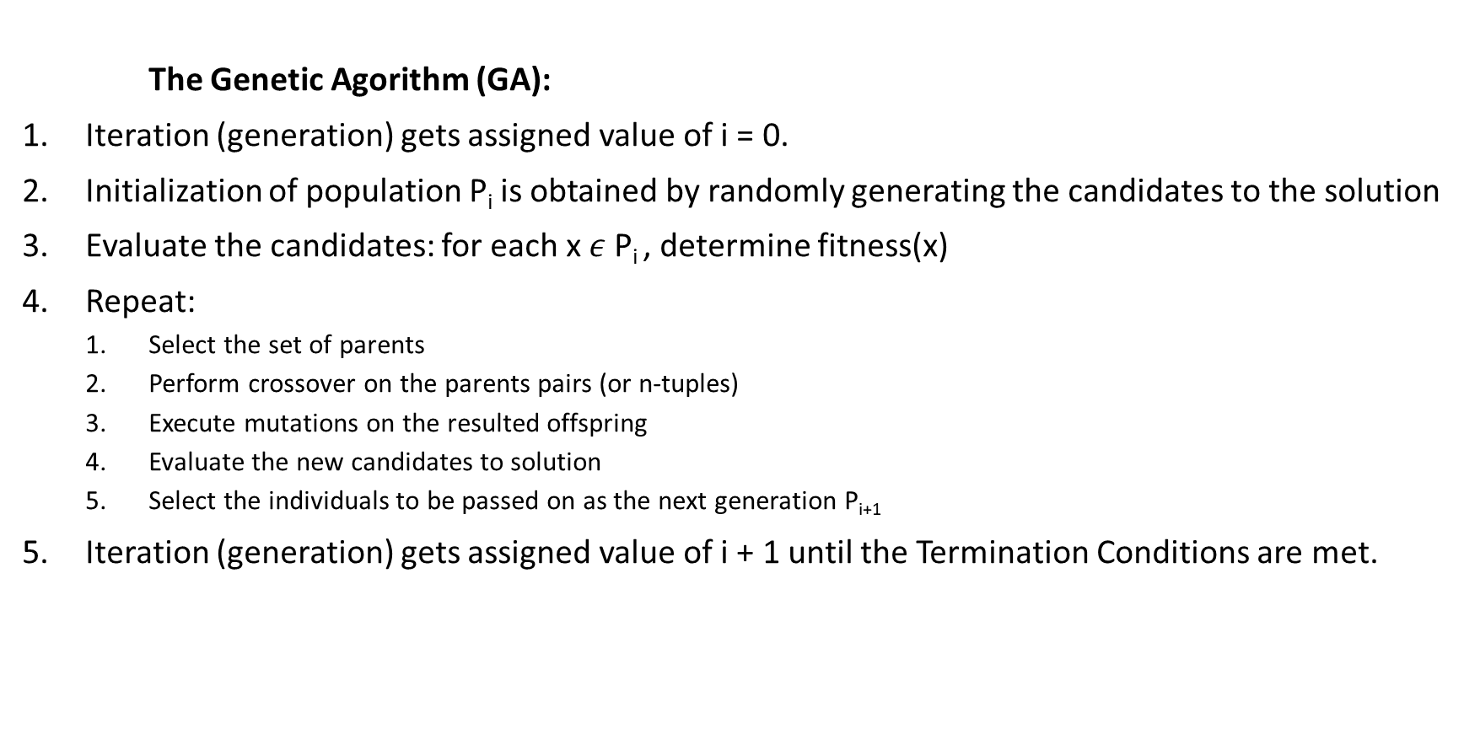
The Traveling Salesman Problem
The Genetic Agorithm (GA):
Iteration (generation) gets assigned value of i = 0.
Initialization of population P_{i} is obtained by randomly generating the candidates to the solution
Evaluate the candidates: for each x $ε$P_{i} , determine fitness(x)
Repeat:
Select the set of parents
Perform crossover on the parents pairs (or n-tuples)
Execute mutations on the resulted offspring
Evaluate the new candidates to solution
Select the individuals to be passed on as the next generation P_{i+1}
Iteration (generation) gets assigned value of i + 1 until the Termination Conditions are met.

